Slide 1

GOVERNMENT COLLEGE OF ENGINEERING,ERODE
B.E Electronics and Communication Engineering
Name of the Student :GOKULNATH G
Naan Mudhalvan Reg No: aut7311106l04
Under the mentor of
Dr. M. Sathyakala
Assistant professor , Dept of IT Department of Information Technology(IT)
Department of Electronics and Communication Engineering
Government College of Engineering
Erode ,PO ,near Vasavi College,TamilNadu-638316,
Affiliated to Anna University ,Chennai.

Slide 2
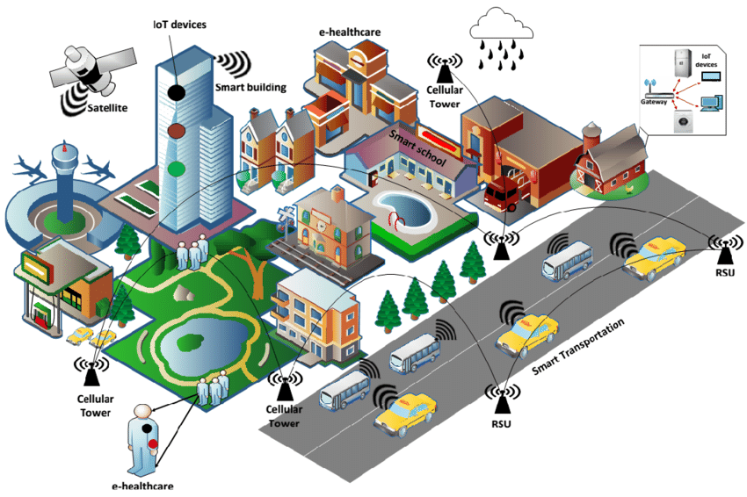

Traffic Management System

Slide 3

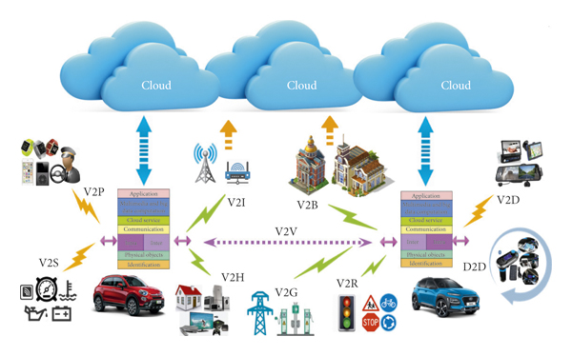
PHASE 2 : INNOVATION

Slide 4
Designing innovation:
Designing innovation into a traffic management system to solve its problems requires a holistic approach that leverages cutting-edge technologies and user-centered design principles.

Slide 5
Step-by-step guide to integrating innovation into a traffic management system:

Slide 6
Problem Identification:
Begin by clearly defining the specific challenges within your traffic management system, such as congestion, accidents, and inefficient traffic flow.

Slide 7
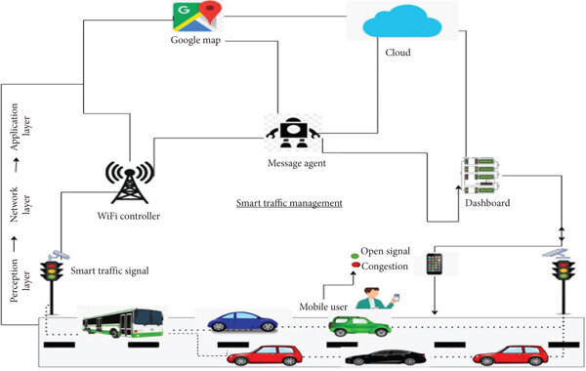

Smart Traffic Signage:
Use digital signage and variable message boards to provide real-time traffic information, detour routes, and safety alerts to drivers.

Slide 8
Data Collection and Analysis:
Implement advanced data collection methods, including sensors, cameras, and GPS systems, to gather real-time traffic data and historical patterns.

Slide 9
Innovative Technologies:
Explore the latest technologies that can transform traffic management:
Artificial Intelligence (AI)
Utilize AI for traffic prediction, intelligent signal control, and anomaly detection.
IoT (Internet of Things):
Install smart sensors and connected infrastructure to collect data and communicate with vehicles.
Big Data Analytics:
Apply big data analytics to process and derive insights from vast amounts of traffic data.
5G Connectivity:
Leverage high-speed 5G networks for real-time data transmission and communication.

Slide 10
Real-time Monitoring and Control:
Develop a centralized control center equipped with real-time monitoring tools, allowing operators to respond swiftly to traffic incidents and adjust signal timings.

Slide 11
Predictive Analytics:
Implement predictive analytics to forecast
traffic congestion,
accidents ,
enabling proactive management.
and other issues,.

Slide 12
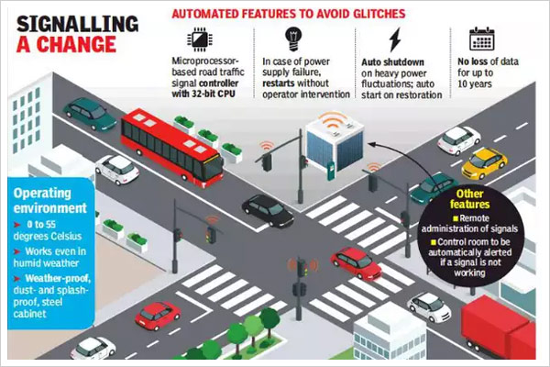


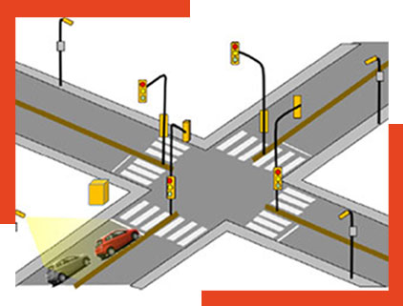

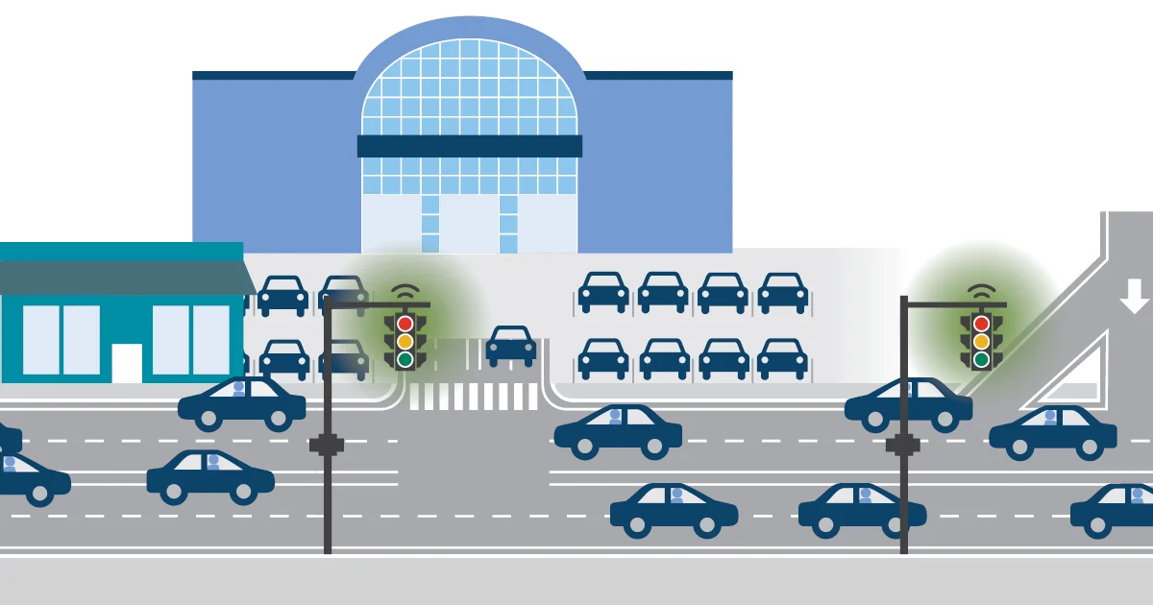
Adaptive Signal Control:
Deploy adaptive traffic signal control systems that adjust signal timings based on real-time traffic data.

Slide 13
User-Centered Applications:
Develop user-friendly mobile apps and web platforms that offer commuters real-time traffic updates, alternative routes, and public transportation information.

Slide 14
Environmental Considerations:
Integrate environmental sustainability into your system, with features like optimizing traffic flow to reduce emissions and promote eco-friendly transportation options.

Slide 15
Performance Monitoring:
Continuously monitor the performance of the traffic management system and gather insights to make data-driven improvements.

Slide 16
Smart Traffic Signage:
Use digital signage and variable message boards to provide real-time traffic information, detour routes, and safety alerts to drivers.

Slide 17
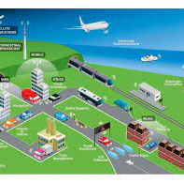
Conclusion:
By integrating these innovative approaches into your traffic management system, you can create a more efficient, safe, and sustainable transportation infrastructure that addresses the challenges of modern urban mobility.

